Slide 1
Sales Analysis of Wine, Beer, and Liquor
Retail + Warehouse Sales Breakdown | SQL + Excel
By: Drake Soltez

Slide 2
Workflow – The Beginning Steps
1. Handling a Corrupted TSV File
Original dataset was a TSV exported from Excel, which introduced:
BOM characters
Mixed delimiters
Hidden tabs and stray characters
Risk of row truncation
2. Creating a Raw Staging Table
Built a table where every column is VARCHAR
Purpose:
Accept messy, inconsistent data safely
Avoid type‑conversion errors during import
Preserve the raw file exactly as‑is

Slide 3
Workflow
3. Secure File Loading via ProgramData
MySQL only loads files from: C:\ProgramData\MySQL\MySQL Server 8.0\Uploads
This is a very important step because this is the only place MySQL will read the file for datasets that are directly uploaded through the table.
Used LOAD DATA INFILE to ingest the dataset safely
4. Building a Cleaning VIEW
Removed BOM characters
Strip stray characters from numeric fields
Convert text → DECIMAL; Convert year/month → INT
Standardize item types
5. Materializing the Final Clean Table
Created a permanent, analysis‑ready table
Based entirely on the cleaned VIEW

Slide 4
Analysis
The analytical questions in this project all build on one another. I began with a broad question:
“What were the total sales for each item type?”
Answering that naturally led me deeper into the dataset:
I broke the totals down by individual item type (Beer, Wine, Liquor)
I separated each category into retail sales and warehouse sales
I compared retail vs. warehouse performance to understand channel behavior
Finally, I combined both channels to calculate total sales per item type

Slide 5



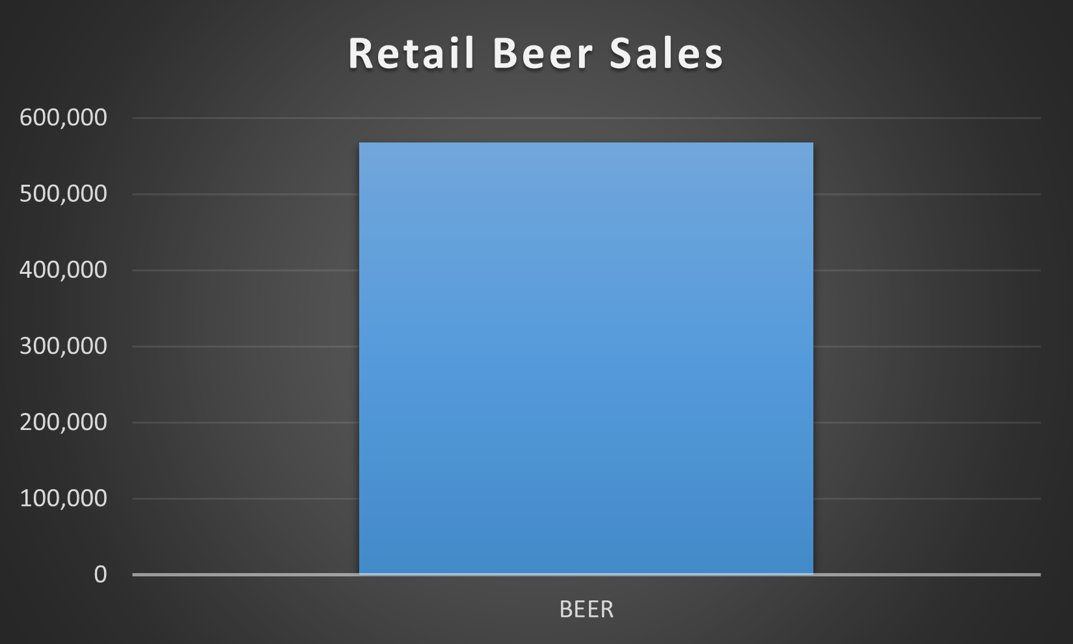
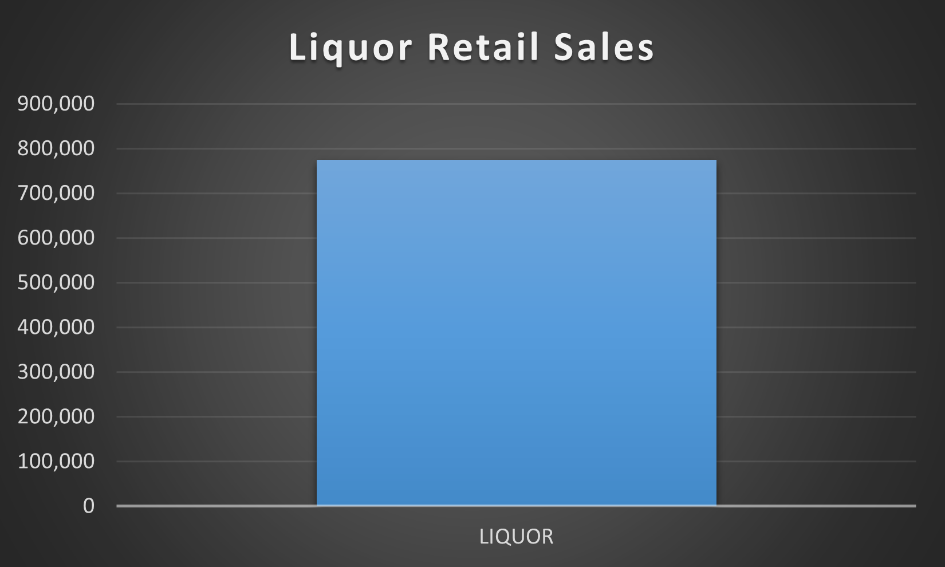
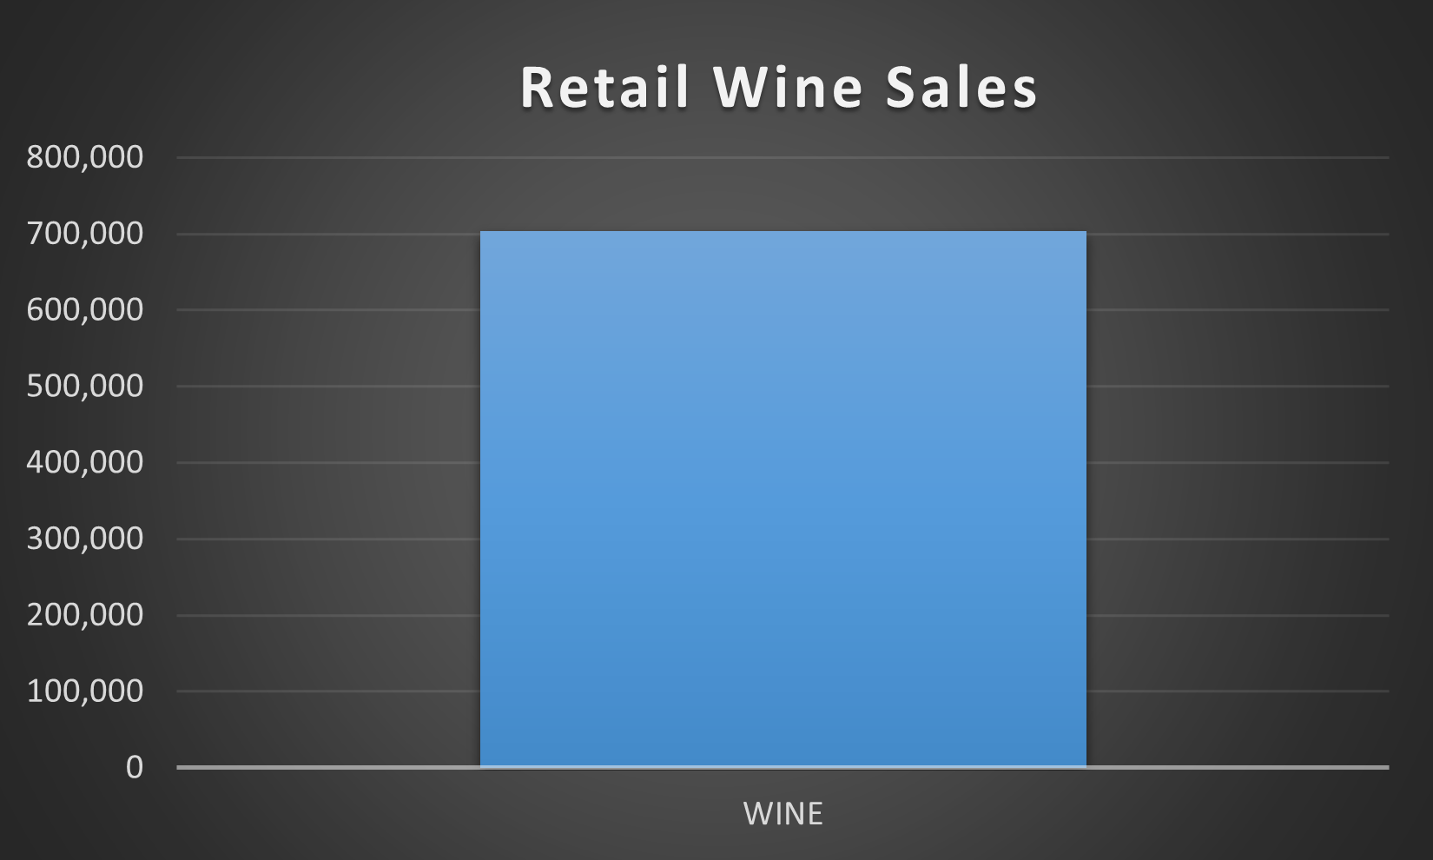
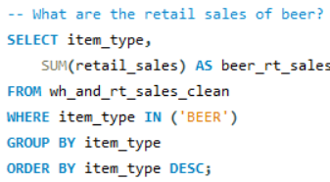
Retail Sales of each Category

Slide 6



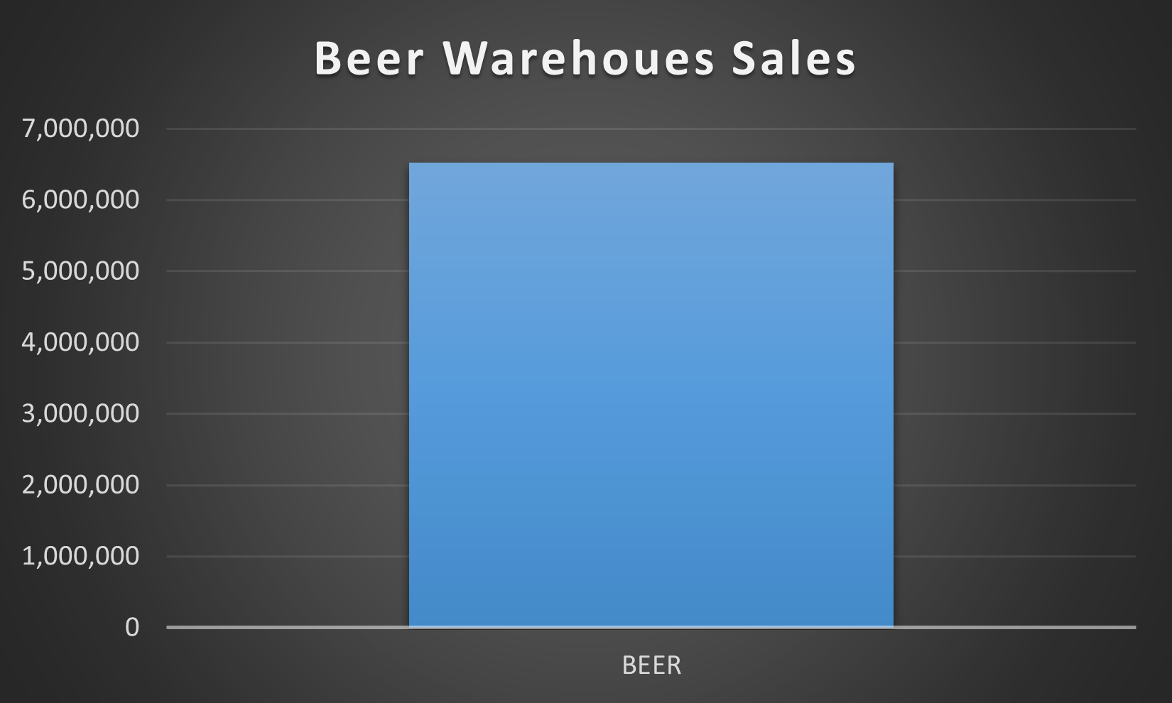
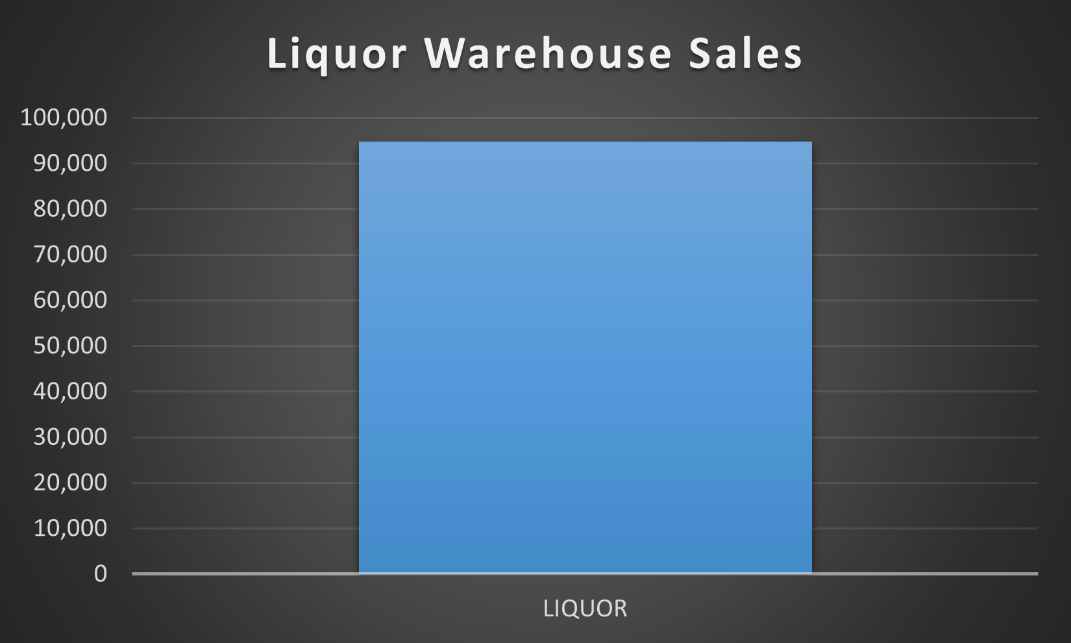
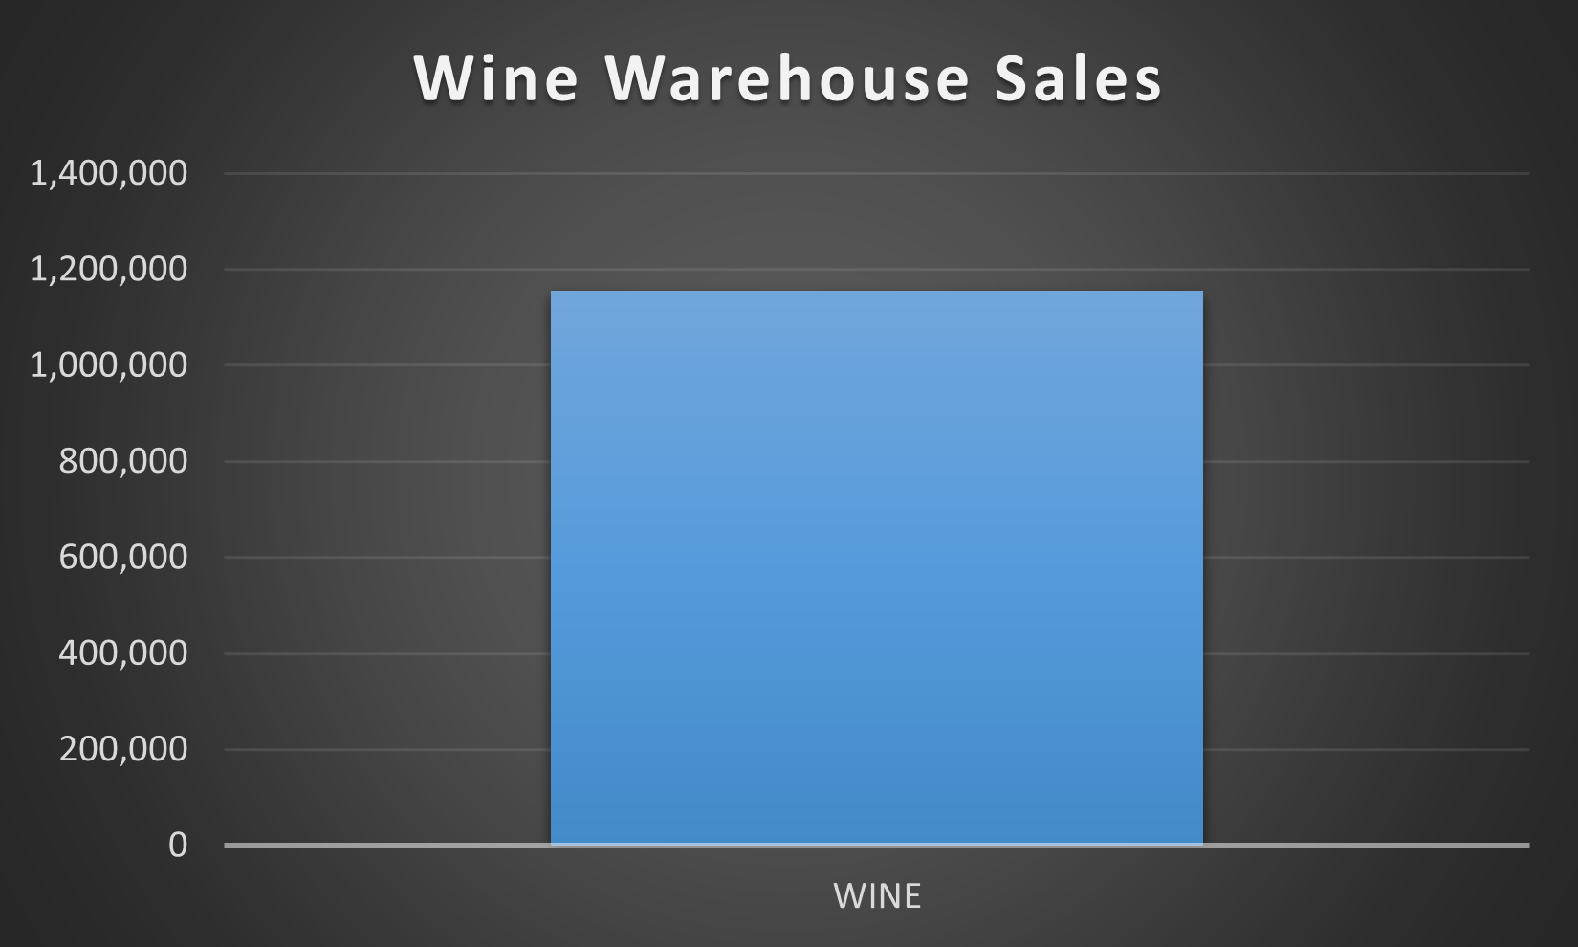
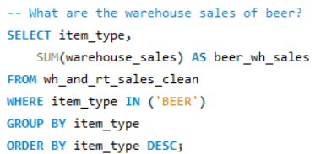
Warehouse Sales of each Category

Slide 7


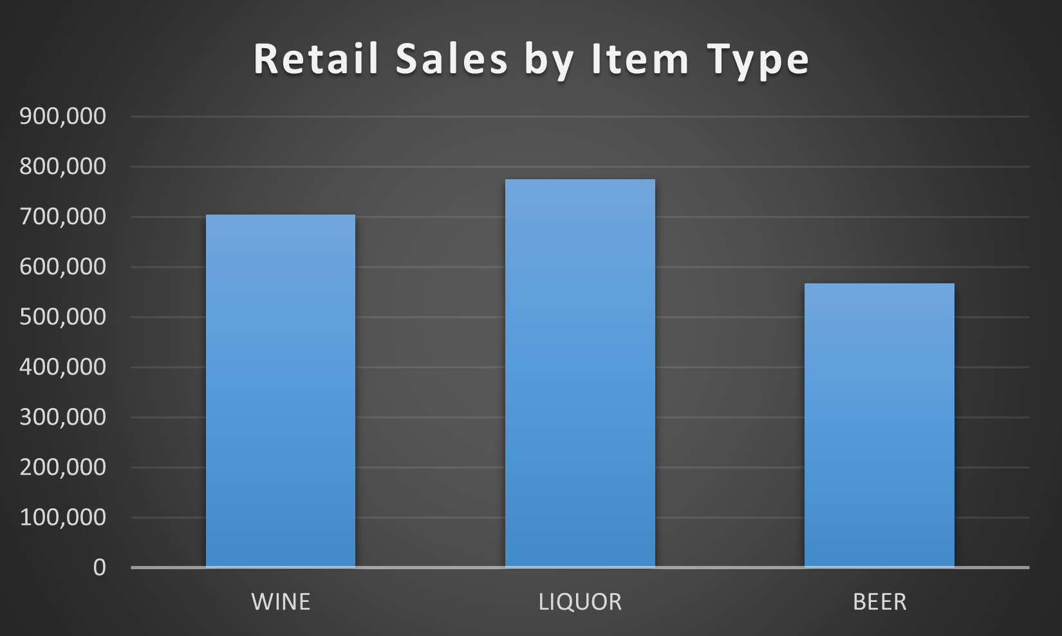
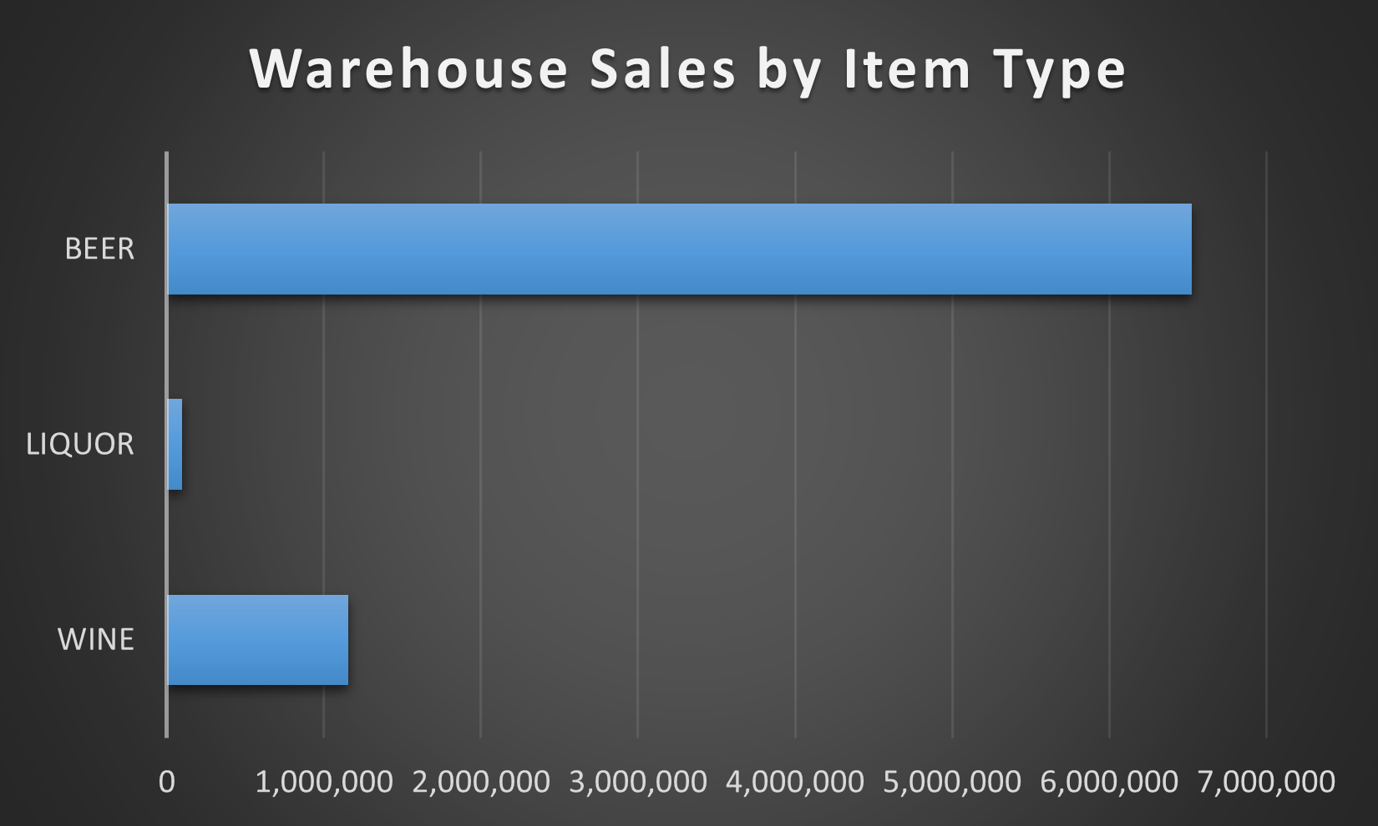
Retail + Warehouse Sales of each Category

Slide 8
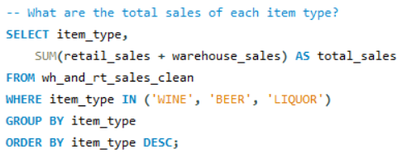

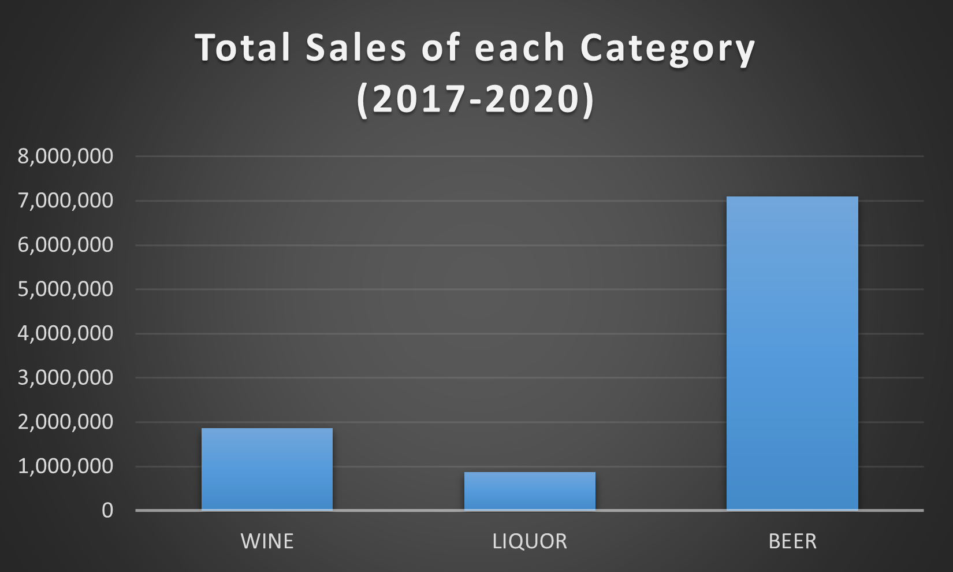
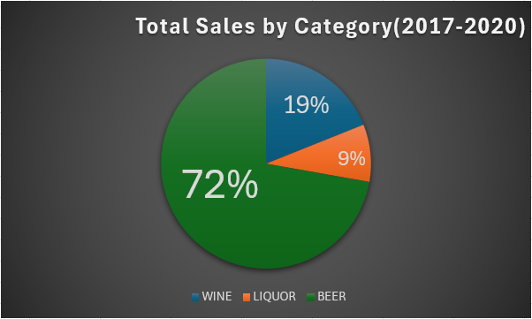
Total Sales by Item Type

Slide 9
Key Insights
Beer overwhelmingly dominates warehouse sales
Liquor leads retail sales despite low warehouse volume
Wine sits in the middle for both channels
Total sales are driven primarily by warehouse volume
Retail and warehouse channels behave very differently across categories

Slide 10
What I’ve Learned
How to safely ingest TSV/CSV files using LOAD DATA INFILE
How to build a raw → staging → cleaned pipeline
How to handle BOM characters, delimiters, and numeric inconsistencies
How to validate data before analysis
Beer is a dominating force throughout the beer industry

Slide 11
Final Deliverables
Cleaned SQL dataset
10‑sheet Excel workbook
Individual CSV exports
PowerPoint case study
Reproducible SQL pipeline

Slide 12
Thank you and questions are welcomed!

